Slide 1



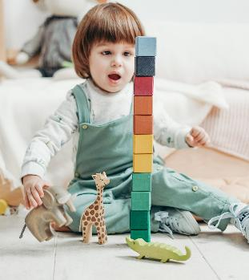
Belgium toys & Games market
YTD ending September 20th 2026
07/10/2026

Slide 2
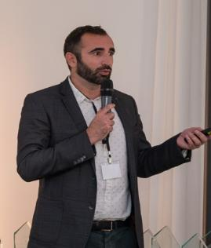
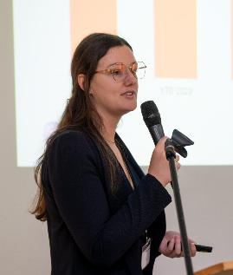
Circana Speakers
Nicolas PONS
Marianne JAMIN
Retail deputy Europe
Senior account manager
France & Benelux
Notes:
See Slide Library for additional layouts

Slide 3
Belgium market grew +10% in value boosted by volume.
2026 is even more dynamic than last year growth (+8,3%)
+10,1%
Value evol%
+13%
Volume evol %
-2.5%
ASP evol %
Source Circana Retail Tracking Service, Belgium YTD September 20th 2026

Slide 4
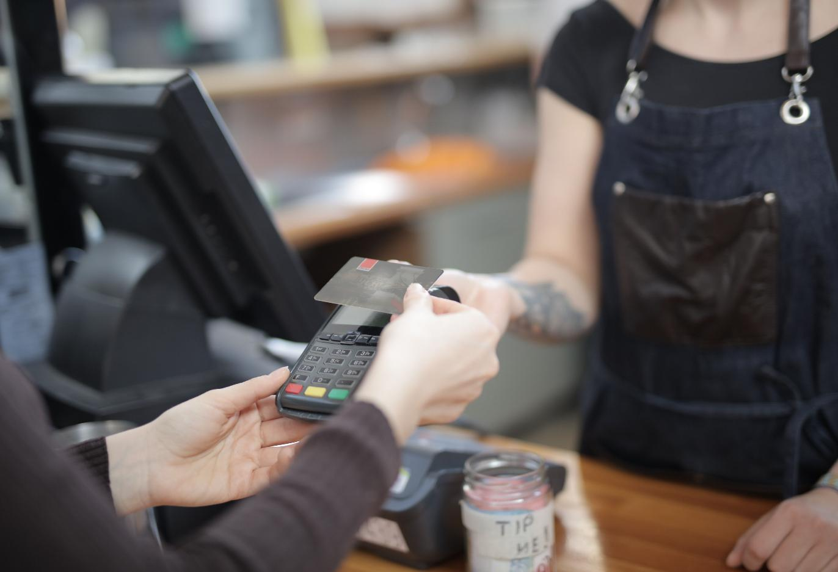
66%
In-store sales (€)
While both channels are growing, consumers have shown a preference for brick-and-mortar stores.
+11% evol €%
+9% evol €%
Source Circana Retail Tracking Service, Belgium YTD September 20th 2026
Notes:
To change the image on this page:
Right click on the image
Change picture > from this device (or clickboard)
To adjust placement, you will need to unlock the image (right click on the image>unlock) – You can either adjust by moving the image left to right, and then cropping the access that may fall outside o the page.

Slide 5







Overall, almost all weeks in 2026 delivered year-on-year growth, regardless of whether they were event-driven or not.
Panel value weekly sales
Recasted Easter Calendar
+12%
Bar Header
Source Circana Retail Tracking Service, Belgium YTD September 20th 2026
Notes:
Pecule de vacances

Slide 6

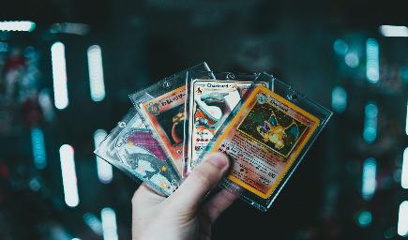


Market boosters
Licenses
Collection
Newness
Teens & Adults
+13%
32% of sales €
+57%
16% of sales €
+23%
29% of sales €
+26%
Source Circana Retail Tracking Service, Belgium YTD September 20th 2026

Slide 7
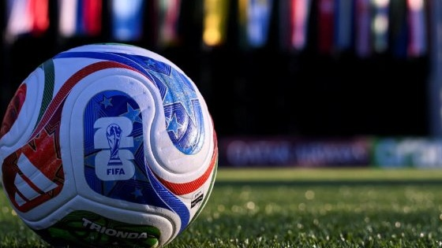
SPORT THEME
+62%
evol€%
Football is the main growth driver, but Sports should not be reduced to Football alone
60%
Sports sales come from Football
Source Circana Retail Tracking Service, Belgium YTD September 20th 2026
      Circana, LLC | Proprietary and confidential
7
Source Circana Retail Tracking Service, Belgium YTD September 20th 2026
Notes:
To change the image:
Click on the full-color section of the image
Right click > change picture (from device or clipboard)

Slide 8

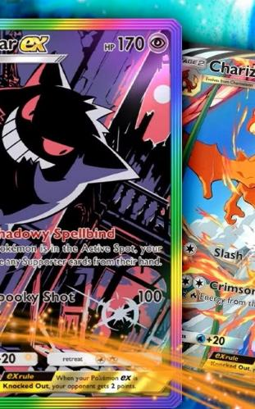

4 supercategories displayed
2-digit growth rate
Games/Puzzles including STCG is the largest contributor to the market growth
Supercategories €% - YTD’26
Evol €% vs. YTD’25
Source Circana Retail Tracking Service, Belgium YTD September 20th 2026
Notes:
GAMES : STCG +83% / rest FLAT
Explorative : Stickers+317% / rest +12%

Slide 9
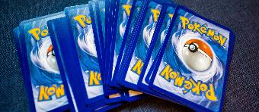



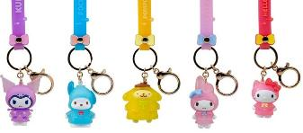

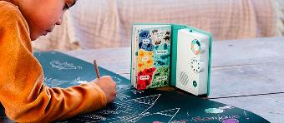



Top 10 largest growing subclasses
Building sets, collectibles, and the impact of the heatwave were the key growth drivers
STCG
Building Sets
Cards & Stickers
Water/Sand Toys
Miscellaneous
+12,6M€
+9,4M€
+3,7M€
+3,5M€
+1,7M€
Water Toys
PS taking & Sound
Card Games
Model & Model Supplies
Reusable Compounds
+0,9M€
+0,6M€
+0,5M€
+0,3M€
+0,3M€
Source Circana Retail Tracking Service, Belgium YTD September 20th 2026

Slide 10
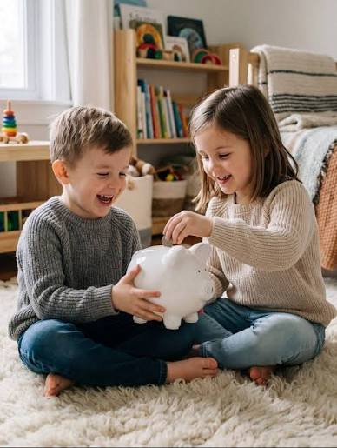
Products priced under €20 account for 75% of unit sales, yet contribute just over a third of total Toys value sales.
VALUE
VOLUME
Evol vs YTD’25
€ % YTD’26
volume % YTD’26
Evol vs YTD’25
+16%
+6%
+9%
+4%
+3%
+2%
+52%
+10%
+19%
+6%
+8%
+5%
+4%
+2%
+58%
+15%
Source Circana Retail Tracking Service, Belgium YTD September 20th 2026
Notes:
La Belgique est impacté par les volumes .
Volume vs 2019: -22%

Slide 11
Top 10 growing Manufacturers & Properties
Outside the well-known top 3 Manufacturers, outsiders are emerging with innovative offerings for kids and Kidults
Top 10 growing Manufacturers – absolute value growth(€M)
Top 10 growing Properties – absolute value growth (€M)
Source Circana Retail Tracking Service, Belgium YTD September 20th 2026

Slide 12

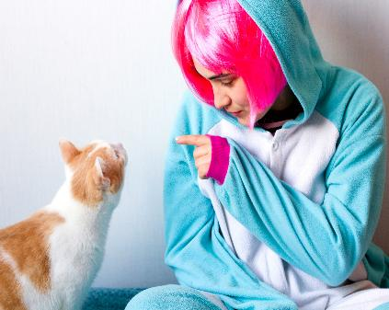

What to expect for Q4?
Outlook
Q4 growth is expected to moderate versus Q1-Q3: tougher comparison base, lower World Cup-related volume support, and a seasonal refocus on child purchases. Performance should be increasingly driven by the Saint Nicholas and Christmas trading periods, benefiting from one additional shopping day versus 2025.
Structural drivers
Market boosters
Trends
to watch
Weekly sales share / Season sales (€%)
Entertainment & licensing
Kidults (12+)
Collection
LEGO & TCG
Sport
Sensory toys & wearables
Kpop Demon Hunters
Tonies
Pokémon/One Piece
Product life cycles
Birth
Girls 0-11
Social commerce
Last minute purchase
Notes:
Last year prefall +8% Fall 4%

Slide 13

Thank you.

